Slide 1
Software to control UTM
By Prathamesh, Sai kumar, Vishal and Rahul

Slide 2
UTM

Slide 3
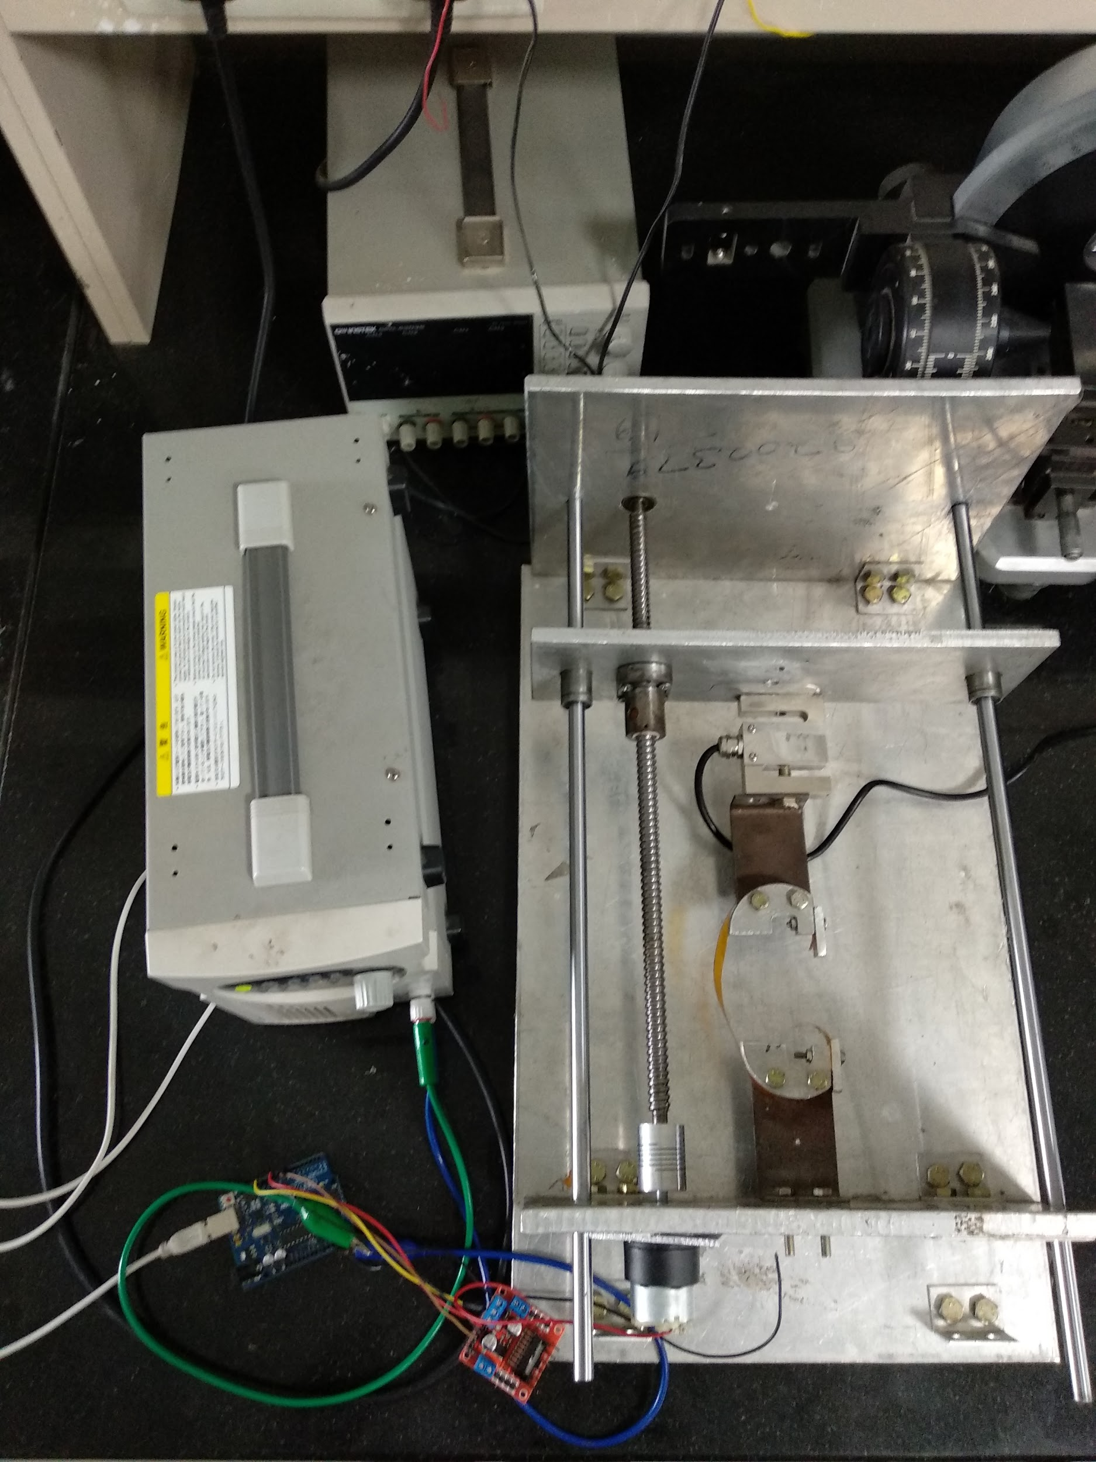

Slide 4
GUI

Slide 5
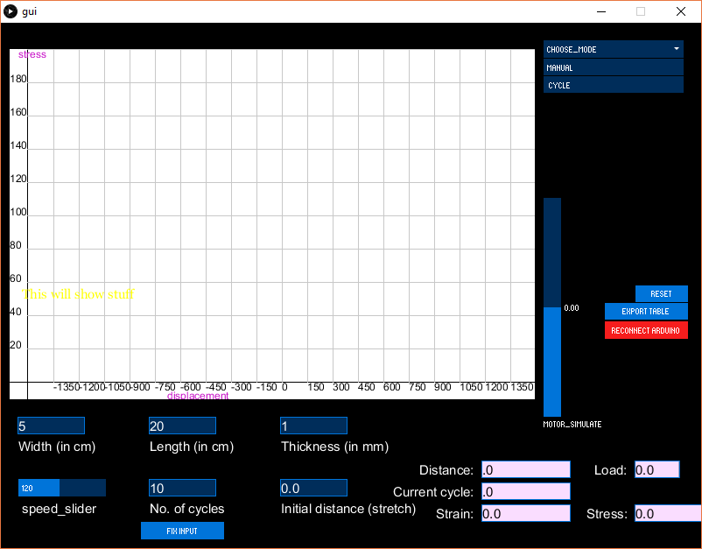
Notes:
Processing, controlP5.
inputs, live panel outputs , mode selector and buttons
1.Inputs are locked after mode is chosen
2.Buttons are hidden and shown appropriately.
3.Choosing manual mode shows 3 new buttons : up, down and pause
4.Choosing cycle mode makes it possible to specify natural point , uppermost point and lowermost point in that order.
5.Clicking reset returns you to initial state and allows you to choose mode again.

Slide 6
Motor control,
Simulation mode,
Live Panel

Slide 7
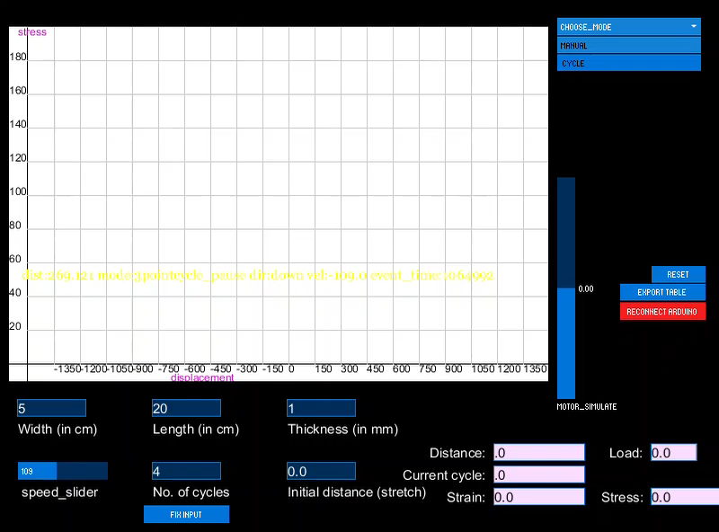
Notes:
Manual
Cycle
speed using a slider.
In manual mode, the user control the motor using up, pause and down buttons.
In cycle mode, user specifies the origin, uppermost point and lowermost point of cycle. Then the software automatically controls the motor for the specified number of cycles. The user can pause/run at any time.
User can click reset to go back to initial state and choose a mode again.
UTM machine is not always available : motor simulation , easy to test the software.
The same instructions that are sent to actual motor through Arduino are sent to the motor simulation.
Load Cell values (shown in graph) are simulated using random numbers(when load cell is not available).

Slide 8
Communication with Arduino
For communicating with Arduino, the StandardFirmata library is used.
First the Standard Firmata library needs to be burned on Arduino. Then the Arduino can be completely controlled by the software on PC.
We can access ports on arduino (for reading loadcell value), send signals to motor etc.

Slide 9
Implementing distance
new_distance= old_distance + (time since last event)*(speed)*(prev direction)
example: new_distance= -50 + (10)*(10)*(+1)=+50 (uppermost point event, direction change)
When distance is needed in between events (required for live panel,graph, table and motor simulation):
current_distance =
last_event_distance + (time since last event)*(speed)*(prev direction)
5 seconds after the above example:
current_distance= 50 + (5)*(10)*(-1)=0
Notes:
No sensor
speed*time
Distance is updated when an event occurs. Events are : pause, up , down , uppermost point reached, lowermost point reached. Basically, every time the motor stops or its direction changes, an event occurs.

Slide 10
Cycle control & adding table rows
At every instant, the software calculates the current position of motor. This value is then shown on live panel & motor simulation.
A new row is added to table . The row includes current distance, load cell value, time, current cycle etc.
If the motor position gets close to the uppermost point the software make it change direction. Also the value of current_cycle is updated. Same for lowermost point.
When current_cycle becomes equal to cycles needed, the motor is stopped.

Slide 11
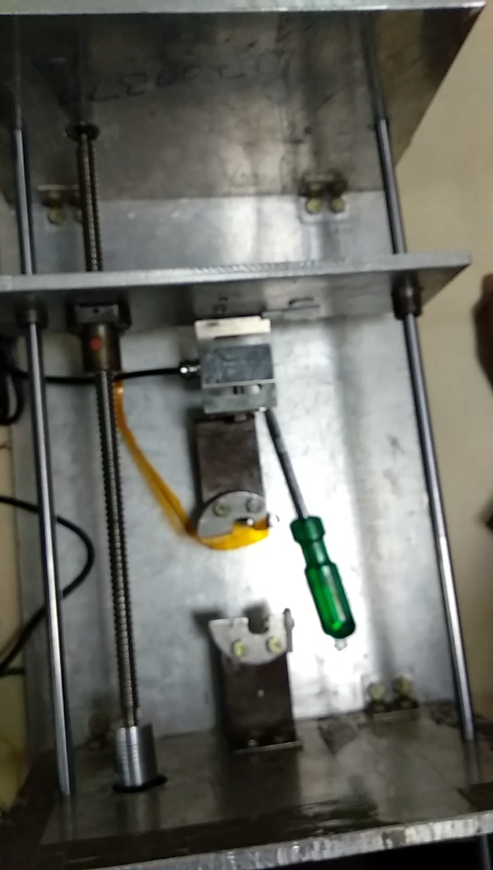

Slide 12
Load Cell readings
Once every instant (configurable, currently about 10 times a second), the software reads the Arduino analog value which comes from the load cell.
Since there are many random errors,the value is smoothed first. This involves taking the average of last ten values.

Slide 14
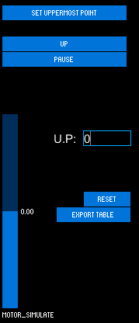
Cycle Mode
In every cycle mode, the user needs to specify the uppermost point (maximum elongation ) and the lowermost point (maximum compression).
This input can be given in two ways:
Direct value
By driving the motor to that position and clicking “Set”

Slide 15
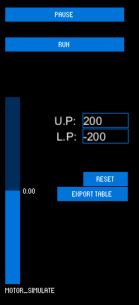
Cycle Mode
After setting the uppermost point and lowermost point , they are displayed as shown in the picture.

Slide 16
Calculating Stress
The stress is calculated using area and Force i.e. load cell value.
→ Stress = Force / area
Area is calculated using the given input’s of width and breadth of the sheet by the user.

Slide 17
Calculating Strain
The stress is calculated based on elongation and compression produced on sheet.
Motor rotation displaces lead screw which produces elongation and compression in sheet.
The original length of the sheet is given as an input by the user.
→ Stress = change in length / original length

Slide 18
GUI Scaling
Size(): This function defines the dimension of display window.
The size which we originally used was width =800 pixels and height =600 pixels
size(800,600);
However, this means that the actual size of the window will be dependent on resolution of user’s screen. It will look too small if user has high resolution screen.

Slide 19
GUI Scaling
Width: System variable that stores the width of user’s screen in pixels
Height: System variable that stores the height of user’s screen in pixels
We scaled the size of windows based on these variables. Thus the software looks uniformly sized on all screens.

Slide 21
GUI Scaling
Everything has been set to the relative pixels of the resolution of the monitor of the user.
Every element of the gui viz buttons, input blocks etc. are scaled.
E.g. surface.setSize( (int) (0.585651537 * displayWidth),
(int)(0.78125*displayHeight) );

Slide 22
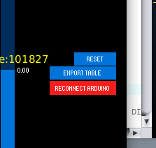
Checking if Arduino is connected
The Software checks if the arduino is connected or not.
If it’s connected then everything works as it is or else it shows a button claiming “Reconnect Arduino” in red.
If Arduino is not connected then the program runs in simulation mode.
This was possible due to the use of try-catch()
block of code.

Slide 23
Exporting Data
The data - Loadcell value, stress , strain, current cycle, current motor direction all being exported to .csv file.
You can export the table (log file) at any point of time by clicking on “Export table” button. THis works in both manual and cycle mode.
A new file is generated every time the required cycles are finished or the user exports data manually.

Slide 25
Graph plot
The main layer in Processing is refreshed multiple times every second.
To avoid redrawing the graph from beginning, the graph is plotted using a separate PGraphics layer over the original layer.
Data is easily mapped in Pgraphics layer to plot on the graph.
It allows us to save the instance of graph as ‘PNG’ format.

Slide 26
Real time data plot
Data from the load cell is plotted in real time on the graph.
Variation in data can be seen on the graph during the progress of experiment.

Slide 27
Two mode to save graph
Screenshots of graph can be saved in both manual and cycle mode:
Manual mode:
In manual mode screenshot of graph can be saved in a file along with the values table by Export button.

Slide 28
Two mode to save graph
Cycle mode:
In cycle mode graph is saved and refreshed after every half cycle.
This ensures the graph to be clean.
After completion of cycle , data for the whole process is exported in an excel file.

Slide 29
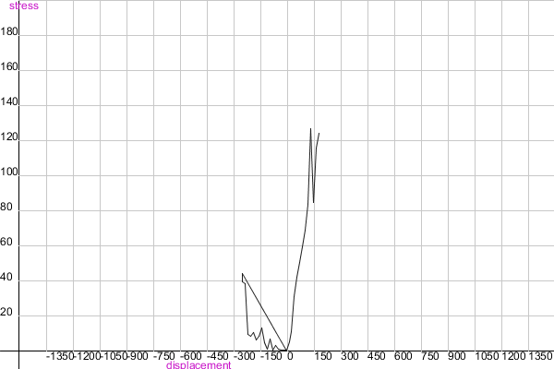
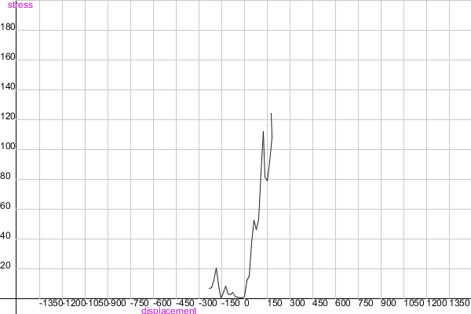
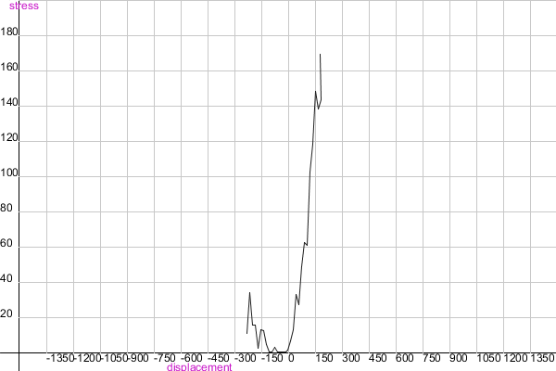
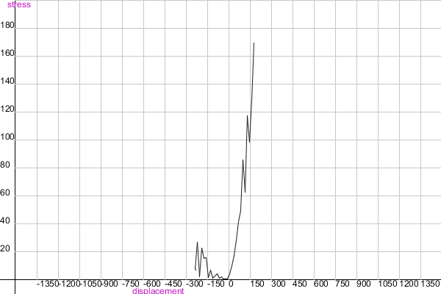

Slide 31
Python script
Python script for combining log files generated from loadstar sensor and from our UTM software.
Using the timestamp values from the two log files, the script generates the combined log file and graphs for each cycle.

Slide 32
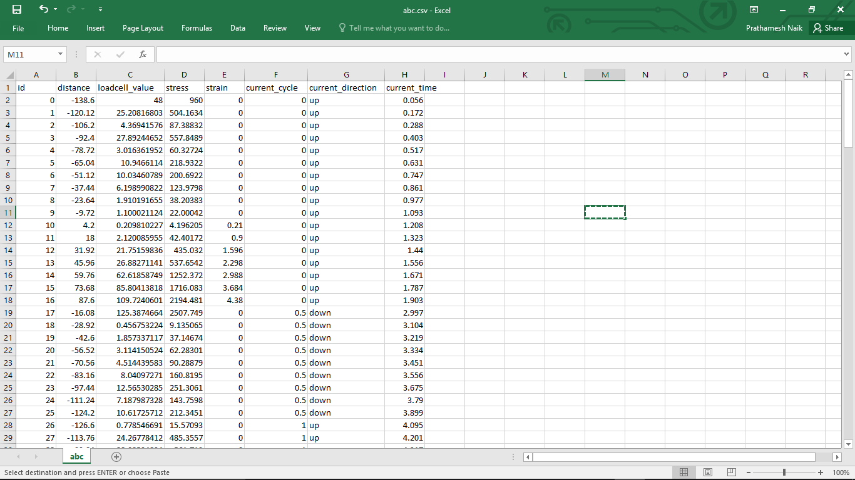

Slide 33
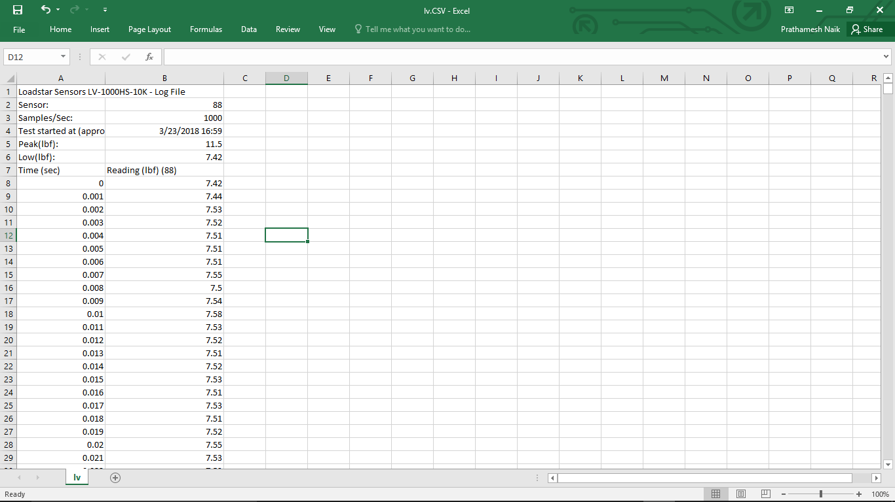

Slide 34
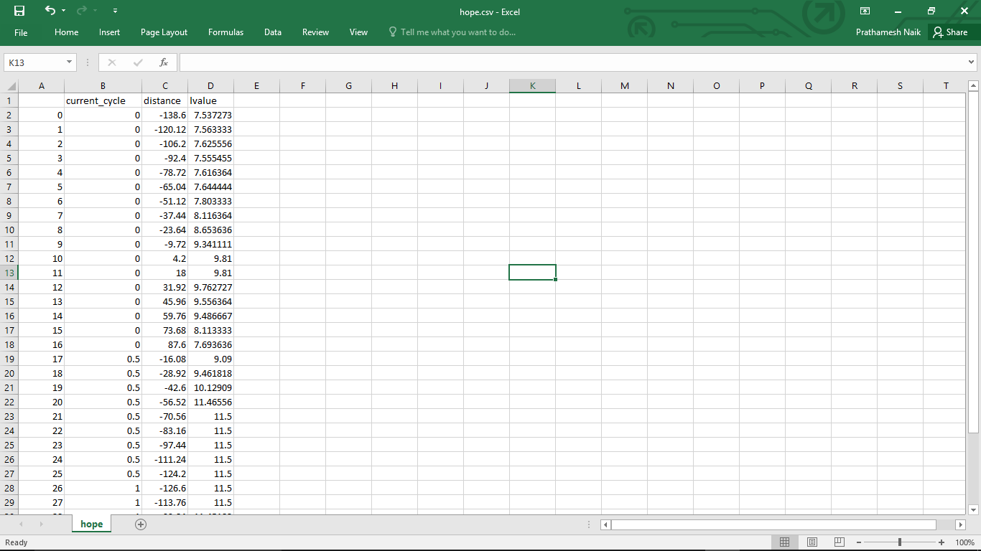

Slide 35
